Slide 1
Angular 14 Deployment

Slide 2


Slide 3

Demo
Deploy an Angular App to GitHub Pages (gh-pages)

Slide 4
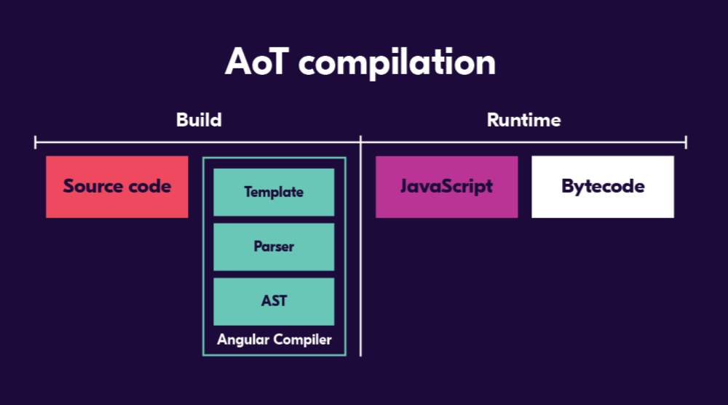
Reference: https://angular.io/guide/aot-compiler

Slide 5


Slide 6
Demo
Angular Tree Shaking

Slide 7
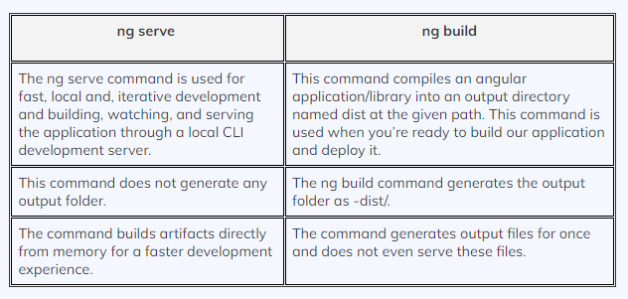
Angular Bundling

Slide 8
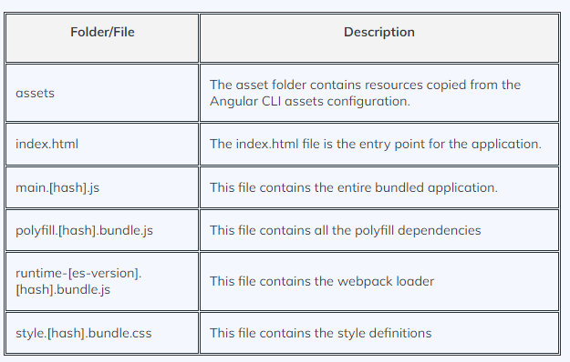
Angular Bundling
Contents of dist folder
Reference: https://angular.io/guide/build

Slide 9
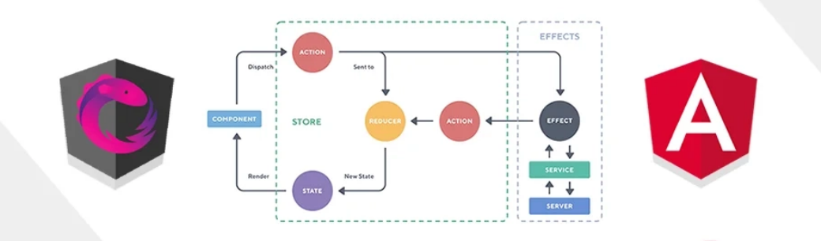
NGRX – Store, Effects

Slide 10
Demo
Use ngrx store with Angular to perform basic CRUD operations

